Slide 1


GRADE 8 ICT/DESIGN
Lesson 1: Define: Brainstorming User Needs
Ms. Abboud • Grade 8 - ICT/Design • Term 1, Week 4

Slide 2
Learning Objectives
WALT - We Are Learning To
WILF - What I'm Looking For
Brainstorm a wide range of user needs for a design challenge.
Categorize related needs into clear, logical groups.
Generated a wide range of ideas, not just 1-2.
My categories are logical and clearly labeled.

Slide 3
Academic Vocabulary
Define
Brainstorm
In the design process, clearly stating what problem you're solving and for whom.
Generating as many ideas as possible without judging them yet.

Slide 4
Frayer Model: Brainstorm
DEFINITION
CHARACTERISTICS
Generating as many ideas as possible without judging them yet.
No idea is 'wrong' during brainstorming; quantity over quality at first; judging comes later.
BRAINSTORM
EXAMPLES
NON-EXAMPLES
Writing 10 different user needs on sticky notes, even ones you're not sure about.
Stopping after 2 ideas because you think they're 'good enough'.

Slide 5
National Identity Integration
UAE values of tolerance and community: genuinely listening to and representing needs different from your own before designing a solution.

Slide 6
STARTER
Today's Challenge: Smart Clothing
Introducing today's challenge: designing 'smart clothing' for a specific group of users.
You'll design for this group over the next 2 lessons.
Hook • Engage & Ask
5 - 10 minutes

Slide 7
LESSON CORE
I Do: Introduce the Challenge
Introduce the smart clothing design challenge - you'll design for a real group of users over the next 2 lessons.
Brainstorming rule: generate ideas without judging them yet - quantity first.
Gradual Release of Responsibility
35 - 45 minutes
1 / 3

Slide 8
LESSON CORE
We Do: Brainstorm as a Group
In groups, brainstorm as many possible user needs as possible - one idea per sticky note.
Aim for 8+ ideas before you stop.
Gradual Release of Responsibility
35 - 45 minutes
2 / 3

Slide 9
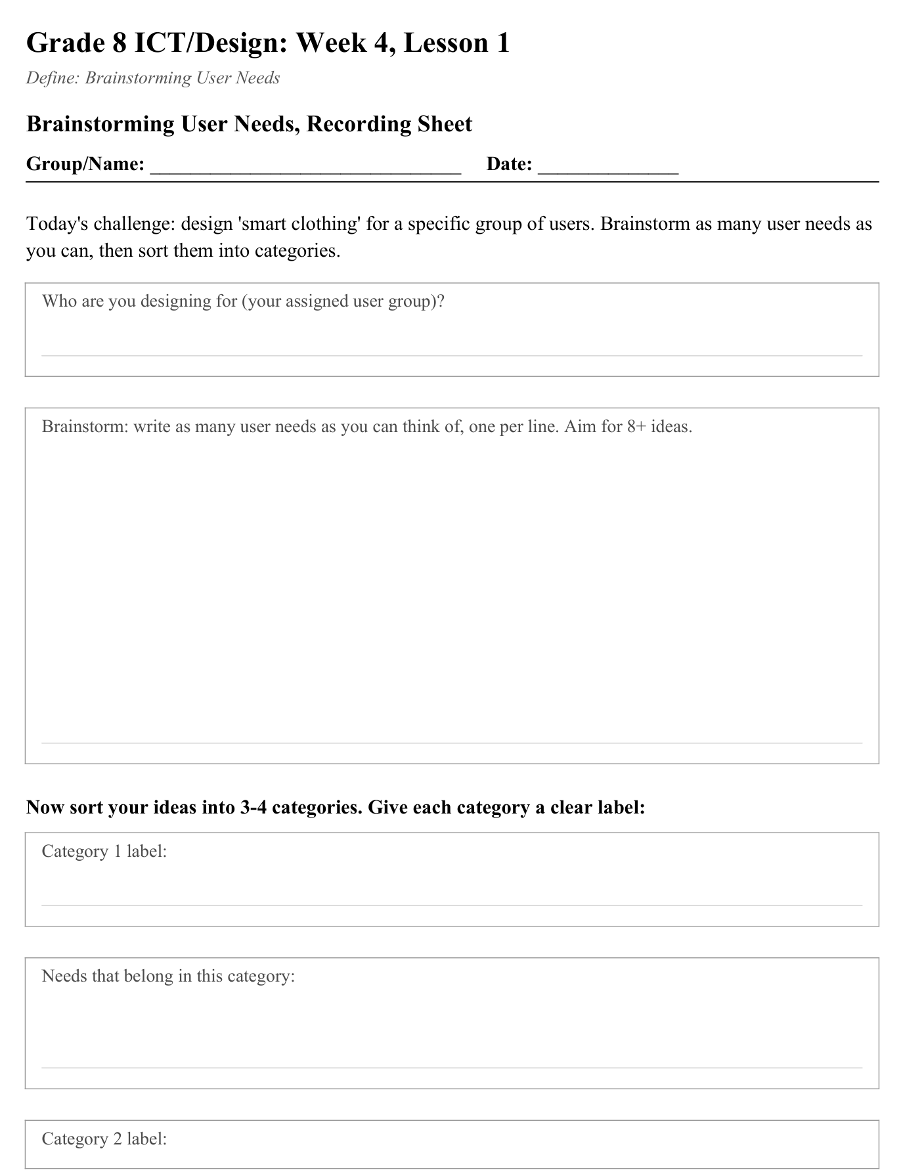
LESSON CORE
You Do: Cluster & Discuss
Cluster your sticky notes into 3-4 labeled categories.
Discuss: which categories matter most?
Activity: Brainstorming User Needs, Recording Sheet
Gradual Release of Responsibility
35 - 45 minutes
3 / 3

Slide 10
CLOSURE
Exit Ticket
Which category of needs does your group think matters most, and why?
Transition & Extend
5 - 10 minutes

